Slide 1
Current State SETUP of SDR

Slide 2
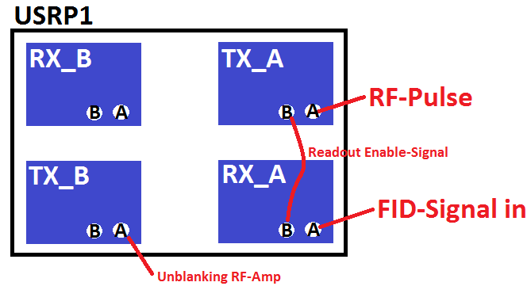
Schematic Connections SDR
Not used

Slide 3
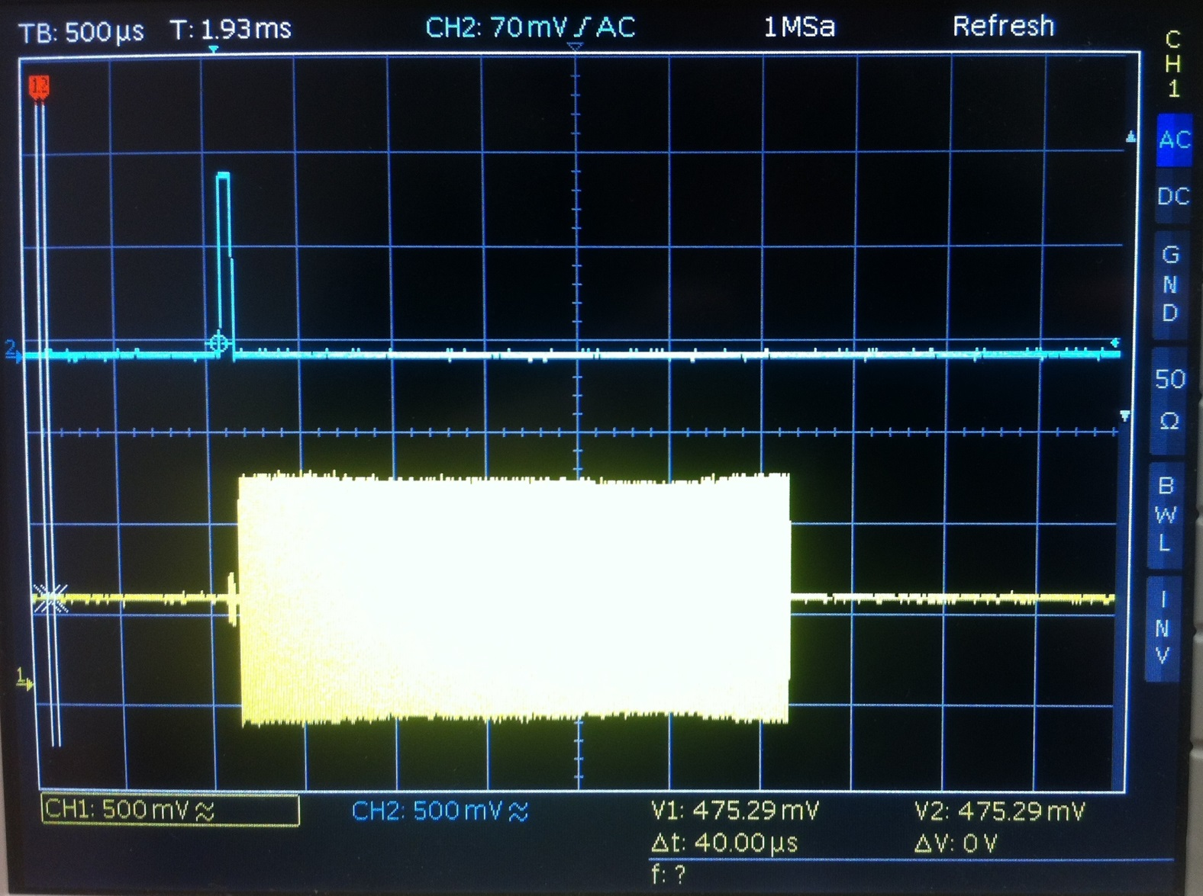
Measured Signals 1
Unblanking Pulse
Recording gate pulse
Excitation pulse

Slide 4
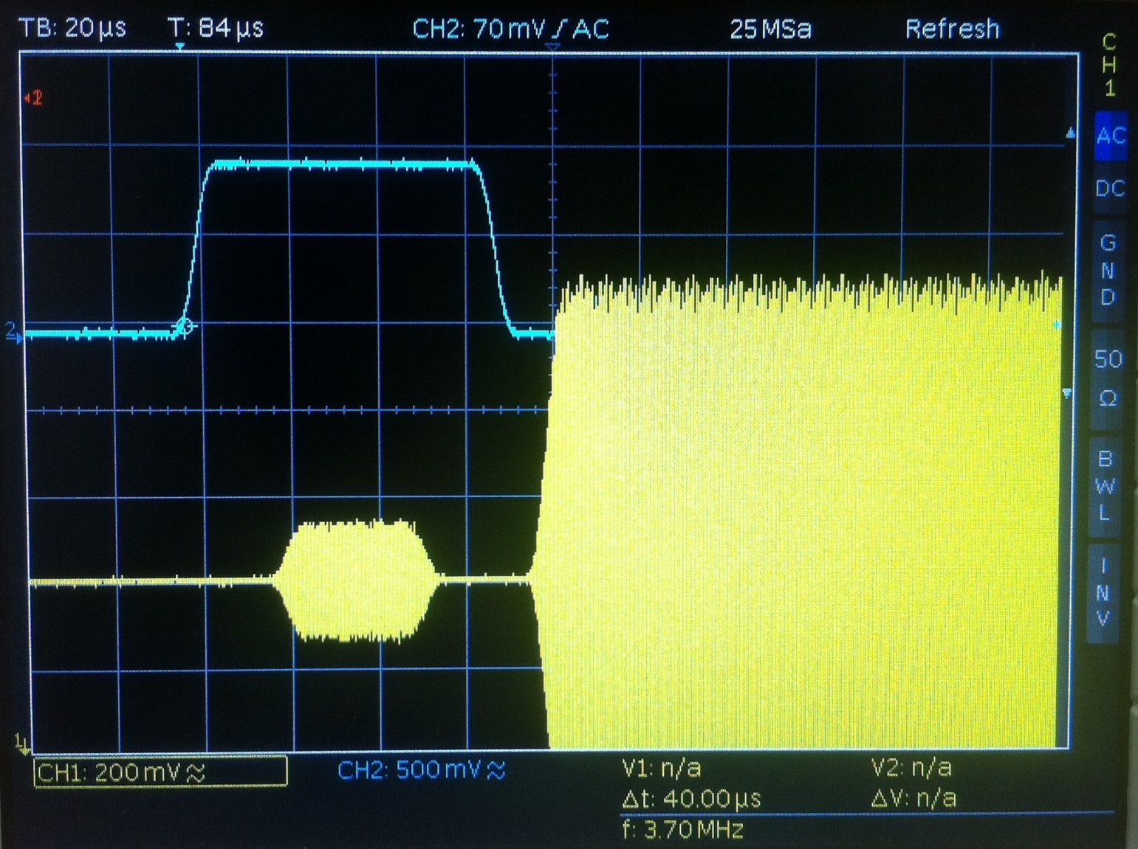
Measured Signals 2
Unblanking Pulse
Recording gate pulse
Excitation pulse

Slide 5
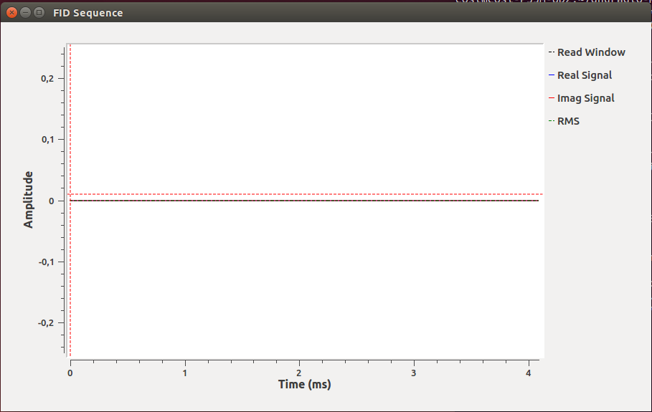
GUI after starting the first time
Why can‘t we see any signals here?

Slide 6
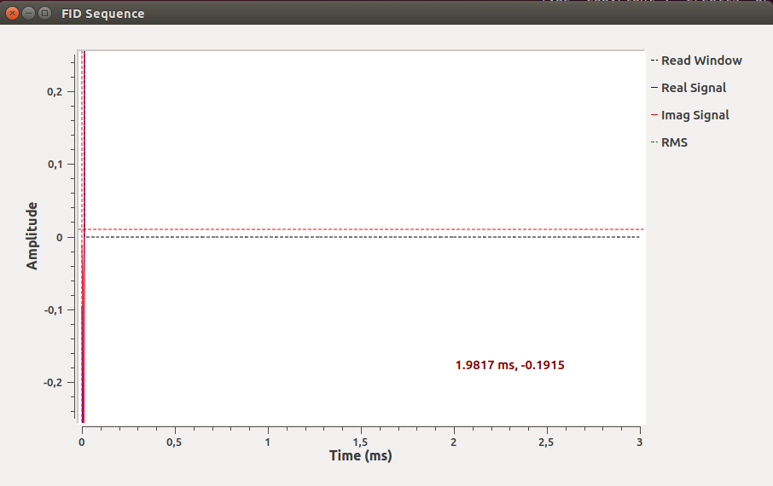
GUI after starting the second time
When starting the sequence
the second time it appears here

Slide 7
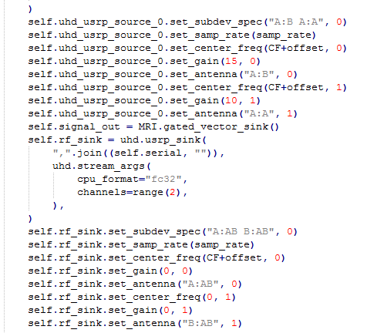
Code Extract from FID_Flowgraph
RX_A board, channels A and B separately
Channel B is defined as first channel,
Input is the recording gate pulse
Channel A is defined as second channel,
Input is the RF-signal

Slide 8
Remaining Issues
Readout Window is not visible in GUI (vertical, dashed lines are missing, even though the readout pulse signal is fed back)
GUI is not updating (is my impression)
Sequence cannot be restarted in same iPython console → produces an syntax error I think this is because the application is not closed appropriately
Why can‘t we see the pulses/signals at the beginning in the GUI when launching the first time?
In your system: What is the gain of your preamplifier for the acquired RF-signal?

